Slide 1
Policy Changes
4 April 2011
Notes:
Policy Changes - <number>
Guidewire training materials contain Guidewire proprietary information that is subject to confidentiality and non-disclosure agreements. You agree to use the information in this manual solely for the purpose of training to implement Guidewire software solutions. You also agree not to disclose the information in this manual to third parties or copy this manual without prior written consent from Guidewire. Guidewire training may be given only by Guidewire employees or certified Guidewire partners under the appropriate agreement with Guidewire.

Slide 2
Lesson objectives
By the end of this lesson, you should be able to:
  Change issued policies
  Change effective date on a policy change
  Interpret policy transaction graphs
  Define the behavior around preemptive changes
  This lesson uses the notes section for additional explanation and information.
  To view the notes in PowerPoint, choose View→Normal or View→Notes Page.
  If you choose to print the notes for the lesson, be sure to select “Print hidden slides.”
Notes:
Policy Changes - <number>

Slide 3
Lesson outline
Policy changes
Policy transaction graphs
Preemptions
Notes:
Policy Changes - <number>

Slide 4

Review: Changes
change
policy term
A change transaction changes policy prior to expiration date
  Coverables added to or removed from policy
  Coverages added to or removed from coverables
  Coverage terms modified
Notes:
Policy Changes - <number>
A change transaction is also referred to as a "policy change".
A "material change" is a change to a policy that affects what is covered. Policy changes typically involve material changes.
Policy changes almost always involve a change to the policy's premium.

Slide 5
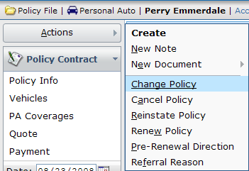
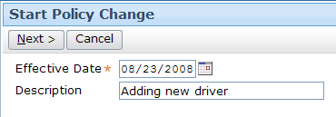
Initiating a change job
Initiated manually from Change Policy menu action
  Can also be initiated from external system
Must specify effective date and optional description
Notes:
Policy Changes - <number>
Although it is not required, it is best practice to provide a description for the change transaction. Otherwise, the transaction can only be identified by its effective date. If several changes are executed against a policy, it can be difficult to find a particular change transaction if the only way the transactions are distinguished is by their effective date (particularly when multiple change transactions can have the same effective date).

Slide 6
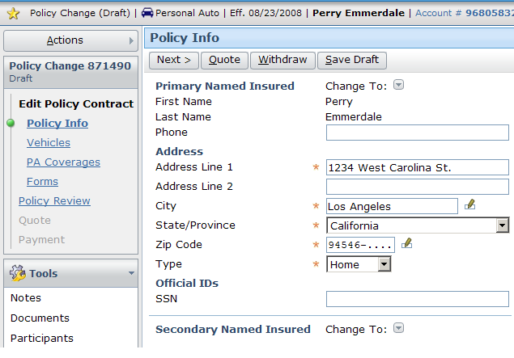
Entering the changes
Wizard contains editable copy of policy as of change transaction's effective date
Notes:
Policy Changes - <number>
After you specify an effective date and optional description, the change wizard is displayed. From this point, you can go to any of the steps prior to the Quote step and modify the policy.

Slide 7
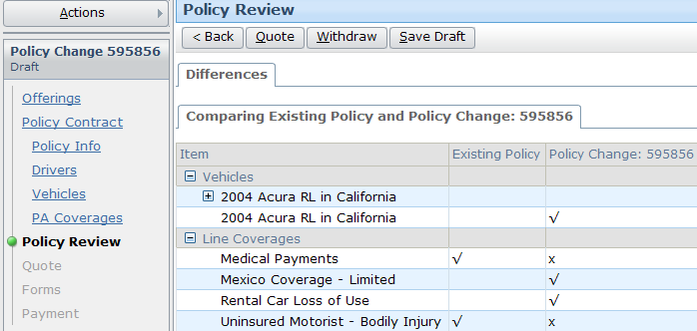
Viewing the changes
Policy Review step details all material changes to policy specified within change transaction
Notes:
Policy Changes - <number>
You can review changes made to the policy on the Policy Review screen. It is an easy way to identify exactly what the transaction is changing or has changed. The differences are displayed using a tree format.

Slide 8
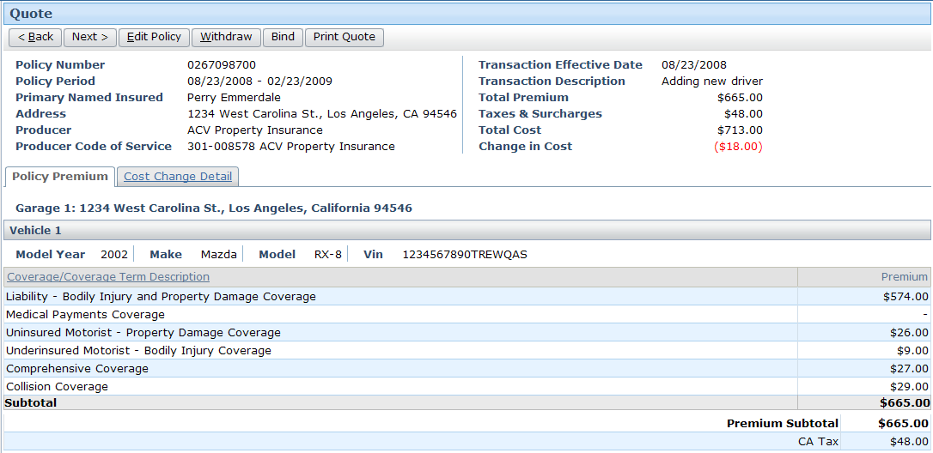
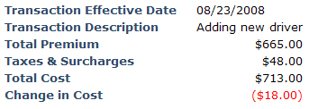
Requoting the policy
Because change typically involves modifications to exposures and/or coverages, policy must be requoted
Notes:
Policy Changes - <number>

Slide 9

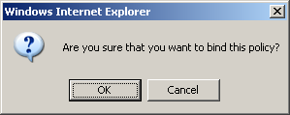
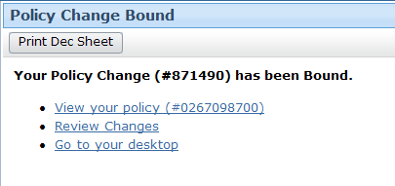
Issuing the change
Binding change is similar to binding and issuing submission
  After clicking Bind, change becomes legal part of contract as of change's effective date
Notes:
Policy Changes - <number>

Slide 10
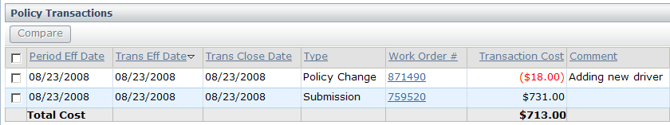
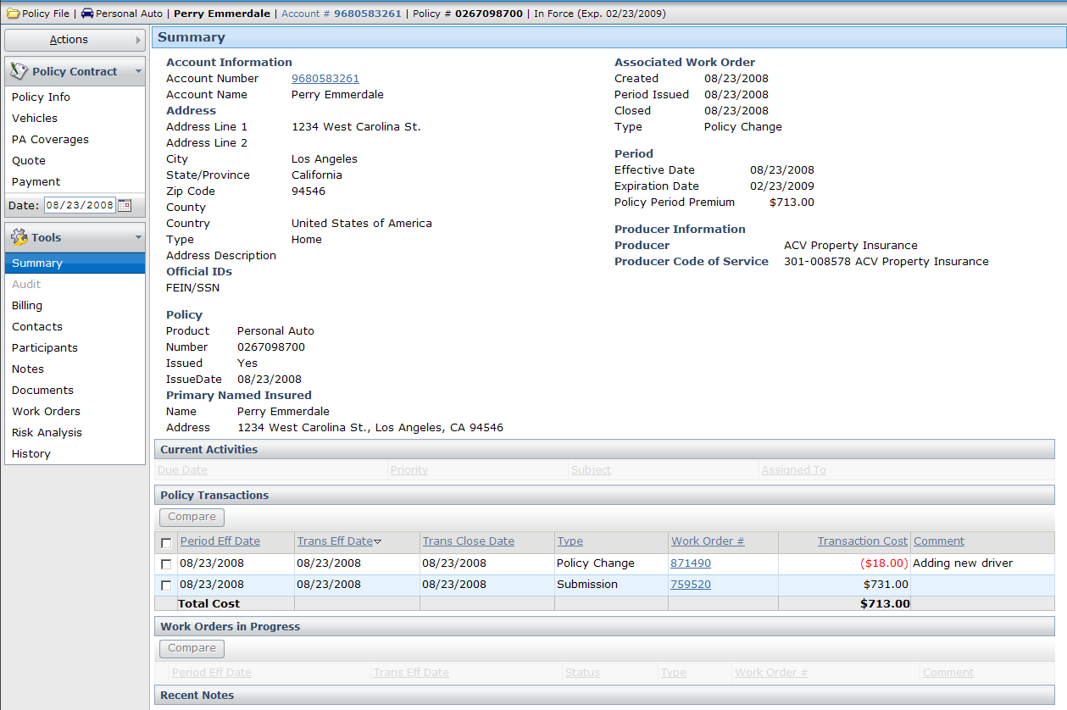
Completed change job
Completed change transactions appear on Summary screen
Notes:
Policy Changes - <number>
Note that the optional description entered at the beginning of the change transaction appears in the Policy Transactions list in the Comment column. This text can help users quickly identify the change transaction if several exist.

Slide 11
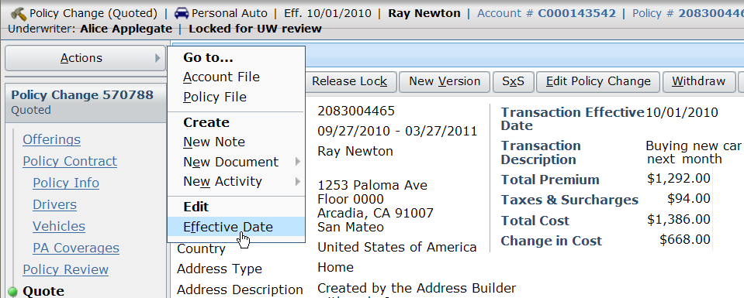
Edit effective date on a policy change
Effective date can be edited after a policy change has already begun
Notes:
It is often the case that a customer will call wanting to make a policy change and all the initial data for the change gets captured but then the effective date of the policy change needs to be modified.
A common use case for this is changing the date on which a coverage starts for a newly acquired vehicle:
A customer is buying a new vehicle, and calls the insurance company to determine how much coverage for the new vehicle will cost; a policy change is started but not completed.
They initially expect to receive the vehicle on a certain date (for example, 10/01 as shown in the screenshot above), so the policy change is begun for that date. However, the vehicle is delayed and is not received until next month (for example, 11/01).
The agent would just like to simply change the effective date of the already in progress change to 11/01.
Most of the time the new effective date of the policy change will be quite close to the old effective date of the policy change.
Policy Changes - <number>

Slide 12
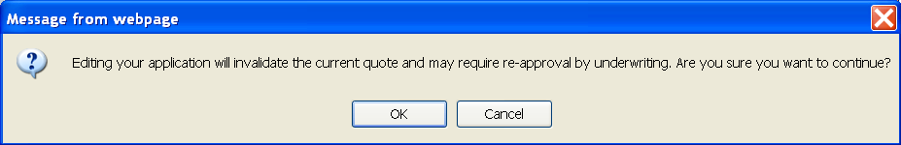
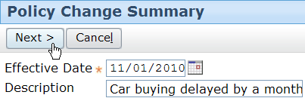
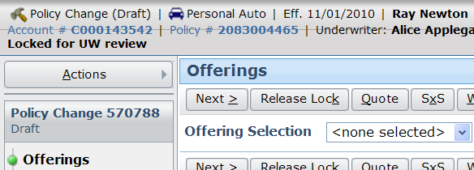
Effective date is edited on the policy change
May require UW approval
Notes:
When you choose to edit the effective date a policy change Summary page opens which allows you to edit the effective date and the description. If you choose to edit effective date the current quote will become invalid.
User cannot change the effective date across transaction boundaries. For example, if the current effective date of the policy change is 11/1/2010 and there was another bound policy change on this policy with an effective date of 11/15, you couldn’t change the effective date of the policy change to 11/16 (but you could change it to 11/14).
Policy Changes - <number>

Slide 13
Lesson outline
Policy changes
Policy transaction graphs
Preemptions
Notes:
Policy Changes - <number>

Slide 14
Policy transaction graphs
policy comes
into effect
policy renewed
or expires
submission
subsequent
transactions
Guidewire documentation uses this graphic convention to represent how transactions change policies over time
  Horizontal axis represents policy term ("real time")
  Vertical axis represents policy as modeled in PolicyCenter ("model time")
Notes:
Policy Changes - <number>
The conventions for policy transaction graphs are discussed on the next set of slides.
Policy transaction graphs are useful for depicting the nature and behavior of complex transaction interactions, including reinstatements, rewrites, preemptions, and out-of-sequence transaction.

Slide 15
Sample scenario: Submission
policy comes
into effect
policy renewed
or expires
submission
A
Submission creates PolicyPeriod which starts on effective date and ends on the expiration date
Policy term is the period of the policy from the effective date until the expiration date
Notes:
Policy Changes - <number>
In policy transaction graphs, each PolicyPeriod is represented as a horizontal bar. Each PolicyPeriod is also given a unique letter (such as the "A" above) which corresponds to the transaction that created it.
Recall that PolicyPeriod is “one version” of a particular policy term at any given time.

Slide 16
Sample scenario: The first change
policy comes
into effect
policy renewed
or expires
submission
A
change 1
B
Policy change creates second version of policy term
  This period (B) is initially based on first policy period (A)
  First PolicyPeriod still exists in database as created, and is superseded by this policy change
Notes:
Policy Changes - <number>
Information about the every PolicyPeriod is kept in its entirety inside the PolicyCenter database. This is done to facilitate any queries which seek to know what the policy looked like at previous points in its own history. For example, an audit job may want to know what the projected payroll was on the first PolicyPeriod and compare it to what it looks like as of the policy change.

Slide 17
Sample scenario: Subsequent changes
policy comes
into effect
policy renewed
or expires
submission
A
change 1
B
change 2
C
Subsequent changes create additional versions
  Each new version (such as C) is based on some other version , typically the last version to be bound (B in the diagram above)
Notes:
Policy Changes - <number>

Slide 18
Sample scenario: Renewals
policy comes
into effect
policy renewed
or expires
submission
A
change 1
B
change 2
C
...
renewal
D
Renewals create new policy term
  Once again, new PolicyPeriod (D) is based on some previous PolicyPeriod (C in the diagram above)
Notes:
Policy Changes - <number>
For convenience sake, the bar representing PolicyPeriod D has been truncated. If the graph were completely drawn, the length of PolicyPeriod D would be identical to that of PolicyPeriod A. D is going to be based on what C looks like at the end of the policy term.
The most recent PolicyPeriod within a policy period or policy term is the period in force. In example above, C is the period in force.

Slide 19
Transaction dates
policy comes
into effect
policy renewed
or expires
bound: 1/20
eff: 1/20
A
bound: 3/07
eff: 4/01
B
bound: 5/18
eff: 5/10
C
bound: 7/01
eff: 7/20
...
D
Every transaction has two dates relevant to these graphs
  Bind date - when was transaction processing completed
  Effective date - when do transaction results come into effect
Notes:
Policy Changes - <number>
Note that the effective date can come before, on, or after the bind date. For example:
The submission job (A) created a policy which became effective the same day the submission was completed. (The policy goes into effect immediately.)
The first change (B) created a change which became effective after the change was bound. (This could be a change in which the insured plans to move but has not done so yet.)
The second change (C) created a change which became effective as of a date before the change was bound. (This could be a change in which the insured purchased a new car but neglected to inform the carrier immediately.)
On the Summary > Policy Transactions list view in the user interface the policy bind date shows up as “Trans Close Date” and the effective date of the change is called the “Trans Eff Date”

Slide 20
Simple scenarios
policy comes
into effect
policy renewed
or expires
bound: 1/20
eff: 1/20
A
bound: 3/07
eff: 4/01
B
bound: 5/18
eff: 5/10
C
bound: 7/01
eff: 7/20
...
D
Scenarios remain simple when:
  Transactions executed in series
    Transaction B starts only after Transaction A finishes
  Transactions become effective in series
    Transaction B becomes effective after Transaction A
Notes:
Policy Changes - <number>

Slide 21
Lesson outline
Policy changes
Policy transaction graphs
Preemptions
Notes:
Policy Changes - <number>

Slide 22
Base periods
submission
A
base for change 1
change 1
B
submission
A
change 1
B
base for change 2
change 2
C
Most policy transactions, including changes, modify a copy of existing PolicyPeriod
  This period is known as "base period" for that transaction
Notes:
Policy Changes - <number>

Slide 23
Preemptions
policy comes
into effect
policy renewed
or expires
submission
A
car 1
change
B
+ car 2
change
C
+ truck
Preemption is a phenomenon which occurs when two transactions have been initiated from same base period
  This occurs when new transaction is started while some other transaction is still in progress
Notes:
Policy Changes - <number>
In the example above, the submission creates a personal auto policy with car 1. Later, a change transaction adds a second car to the policy. However, before the transaction is bound, a second change is started which adds a truck to the policy. The "truck" change job must be based on the latest bound version. Because the "car 2" change job has not completed, the latest bound version is version A, the same version that the "car 2" job was based off of.

Slide 24
Preempting job
policy comes
into effect
policy renewed
or expires
submission
A
car 1
change 1
+ truck (bound first)
B
preempted
change
+ car 2
C
When two or more jobs are started from same base period, first job to be bound preempts (wins out over) all other jobs
  Losing jobs must be modified to handle preemption
Notes:
Policy Changes - <number>

Slide 25
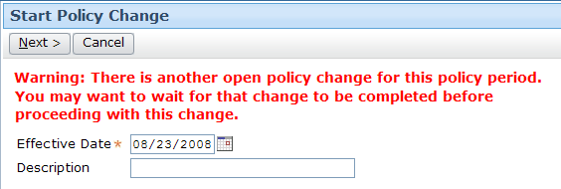
Preemption warning: Policy change
submission
A
car 1
change
B
+ truck
change
C
+ car 2
Notes:
Policy Changes - <number>
When you initiate a change and another change is in progress, you are warned before the change wizard is initiated.

Slide 26
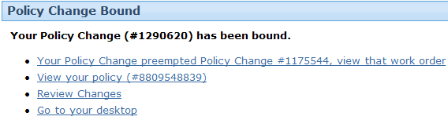
Preempting change
submission
A
car 1
change
B
+ truck (“winner”)
change
C
+ car 2
Notes:
Policy Changes - <number>
When a change job preempts other transactions, the Policy Change Bound screen provides links to preempted transactions.

Slide 27
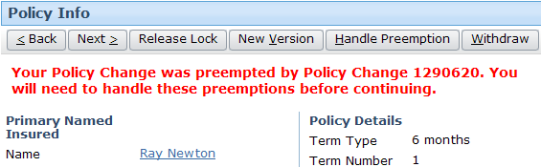
Preempted change
submission
A
car 1
+ truck
change
B
change
C
+ car 2 (“loser”)
Notes:
Policy Changes - <number>
When a change job is preempted, the user is alerted to this when trying to complete the preempted job.

Slide 28
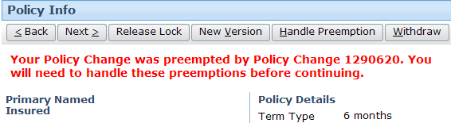
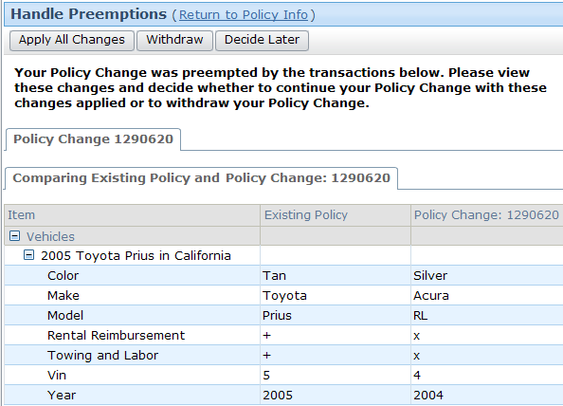
Handling preemptions
You can either apply all changes or withdraw the change transaction
Notes:
Policy Changes - <number>
The comparisons are shown in a tree format for the preempted changes.
The "Decide Later" button makes no changes to the policy or the preempted transaction. It has the effect of simply closing the screen.
In the screenshot above the differences are shown as a tree format comparing the Submission and the Policy Change that was bound earlier.

Slide 29
Applying all changes from preempted job
policy comes
into effect
policy renewed
or expires
submission
A
car 1
car 1
+ truck
change
B
car 1
+ truck
+ car 2
change
C
If all changes from preempted job are applied, then period created from preempting (winning) transaction becomes base period for preempted (losing) transaction
Notes:
Policy Changes - <number>

Slide 30
Lesson objectives review
You should now be able to:
  Change issued policies
  Change effective date on a policy change
  Interpret policy transaction graphs
  Define the behavior around preemptive changes
Notes:
Policy Changes - <number>

Slide 31
Review questions
For each of the following, identify whether the statement applies to submission jobs, change jobs, or both.
It can be started manually.
It can only be executed off of an existing policy.
It requires you to identify the producer of record.
It can be withdrawn.
It can be declined.
It requires a new quote to be generated.
Notes:
Policy Changes - <number>
Answers
1. Both
2. Change
3. Submission
4. Both
5. Both
6. Both

Slide 32
Reservation of rights
Copyright © 2011 Guidewire Software, Inc. All Rights Reserved.
This file and the contents herein are the property of Guidewire Software, Inc. Use of this course material is restricted to students officially registered in this specific Guidewire-instructed course. Replication or distribution of this course material electronically or in paper format is prohibited without express permission from Guidewire.
Guidewire, Guidewire Software, Guidewire ClaimCenter, Guidewire PolicyCenter, Guidewire BillingCenter, Guidewire ContactManager, Guidewire InsuranceSuite, Guidewire Education, and the Guidewire logo are trademarks or registered trademarks of Guidewire Software, Inc. All other trademarks are the property of their respective owners.
Notes:
Policy Changes - <number>

